Slide 1
GUIzero
Part 2 - Commands

Slide 2
Commands
Widgets in guizero can be given a command when created, which can be used to call a function when the widget is used.
By using commands you can make your GUI change and take actions when the user uses it:
e.g. clicking a button, selecting an option, typing a message.

Slide 3
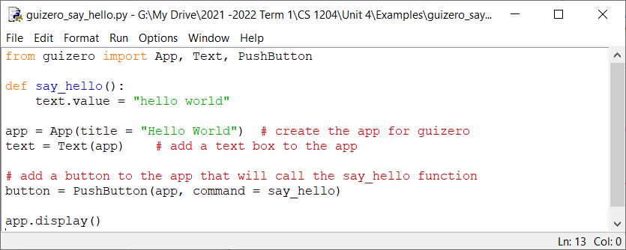
Example
Create an application which puts hello world on the GUI when a button is pressed:
You should get a window containing a button, that when clicked, displays text that reads “hello world”.

Slide 4
Resources
You will not be given a lesson/tutorial on how to use everything in guizero. You are expected to refer to the guizero webpage. The ‘Using guizero’ and ‘Widget’ menus are where you will find information/examples for guizero.
GUIZERO support page

